Slide 1
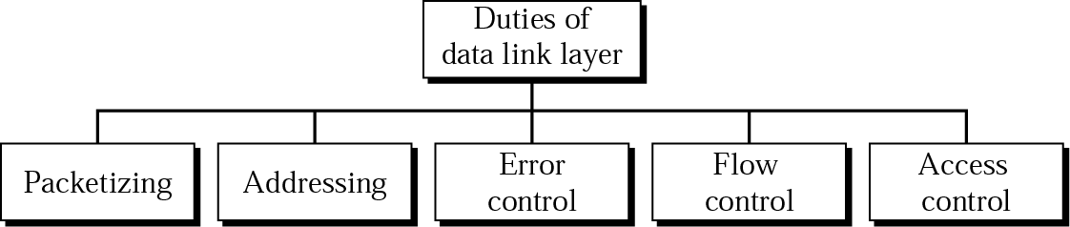
The Link Layer and Local Area Networks
Understand principles behind link layer services:
error detection, correction
sharing a broadcast channel: multiple access
Understanding Link Layer protocol: PPP
Understanding local area network: Ethernet

Slide 2
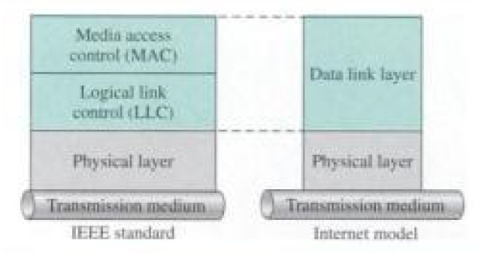
Introduction and Services
Data link layer is responsible for carrying packets from one hop to the next hop
Data link layer has local responsibility
Data link layer is divided into two functionality-oriented sublayers
- Logical Link Control (LLC)
- Medium Access Control (MAC)

Slide 3
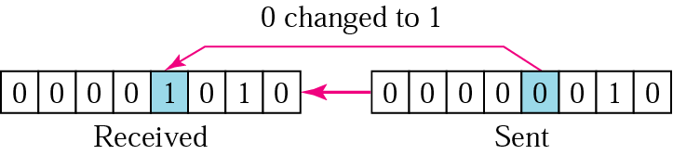
Error Detection and Correction:
Data can be corrupted during transmission.
Types of Error :
Single-Bit Error
Burst Error
Single bit error:
In a single-bit error, only one bit in the data unit has changed.

Slide 4
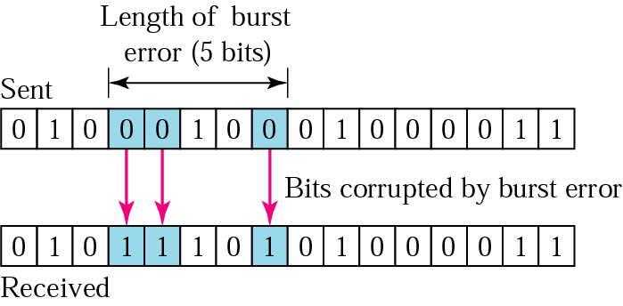
Error Detection and Correction:
Burst Error:
A burst error means that 2 or more bits in the data unit have changed.

Slide 5
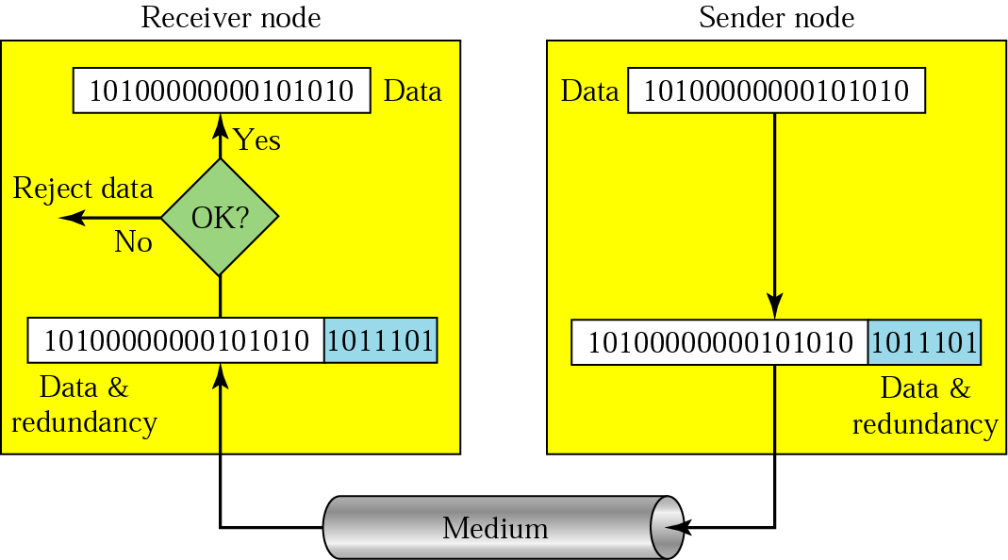
Error Detection and Correction:
Error Detection:
Error detection uses the concept of redundancy, which means adding extra bits for detecting errors at the destination.

Slide 6
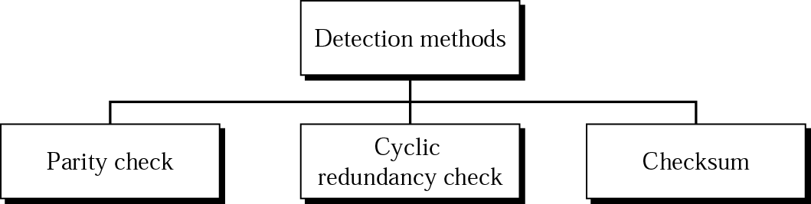
Error Detection and Correction:
Error Detection Methods:

Slide 7
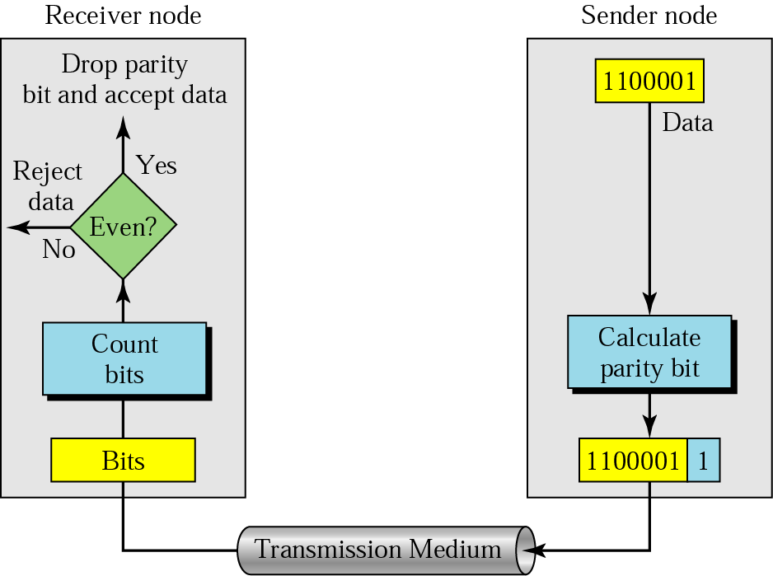
Error Detection and Correction:
Simple Parity Check:
Even or Odd parity check: In parity check, a parity bit is added to every data unit so that the total number of 1s is even (or odd for odd-parity).

Slide 8
Error Detection and Correction:
Suppose the sender wants to send the word world. In ASCII the five characters are coded as
1110111 1101111 1110010 1101100 1100100
The following shows the actual bits sent
11101110 11011110 11100100 11011000 11001001
Now suppose the word world is received by the receiver without being corrupted in transmission.
11101110 11011110 11100100 11011000 11001001
The receiver counts the 1s in each character and comes up with even numbers (6, 6, 4, 4, 4). The data are accepted.
Now suppose the word world is corrupted during transmission.
11111110 11011110 11101100 11011000 11001001
The receiver counts the 1s in each character and comes up with even and odd numbers (7, 6, 5, 4, 4). The receiver knows that the data are corrupted, discards them, and asks for retransmission.

Slide 9
110110001--- data unit
Codeword--- even parity check--- 1101100011--→
Codeword received----- 1101100011--- 6 1’s---even---- no error
What if ---- 1001100011—5 1’s ---odd --- error---- discard & retransmission
What if ---1011100011---6 1’s ---even --- no error---wrong decision
Simple parity check is suitable for detecting single bit error. It can detect burst errors only if the total number of errors in each data unit is odd.

Slide 10
Suppose the following block is sent:
10101001 00111001 11011101 11100111 10101010
However, it is hit by a burst noise of length 8, and some bits are corrupted.
10100011 10001001 11011101 11100111 10101010
When the receiver checks the parity bits, some of the bits do not follow the even-parity rule and the whole block is discarded.
10100011 10001001 11011101 11100111 10101010
In two-dimensional parity check, a block of bits is divided into rows and a redundant row of bits is added to the whole block.

Slide 11
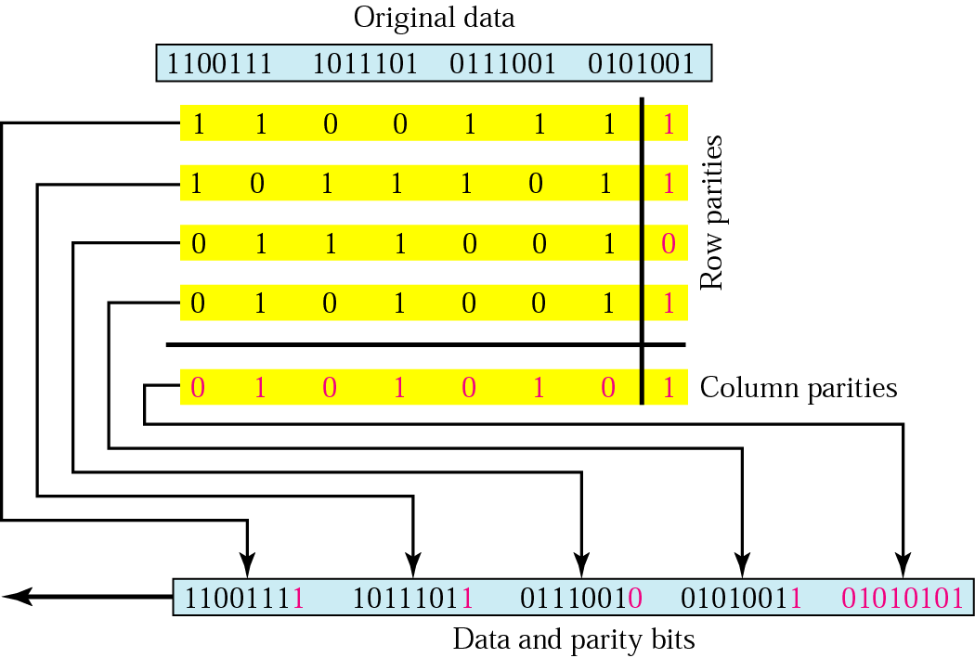
Error Detection and Correction:
Two Dimensional Parity Check:

Slide 12

CRC ( CYCLIC REDUNDANCY CHECK):
Most powerful technique
Performs binary division
Sequence of redundant bits called the CRC remainder is appended to the end of data unit
Resulting data unit is exactly divisible by predetermined binary number
At the destination, incoming data unit is divisible by the same binary number
No remainder – data is proper and accepted
There is remainder – data is damaged and rejected
Redundancy bits are derived by dividing the data unit by a predetermined divisor and remainder is the CRC
Two qualities:
CRC must have exactly one bit less than the divisor
After appending CRC at the end of the data, resulting sequence exactly divisible by the divisor

Slide 13
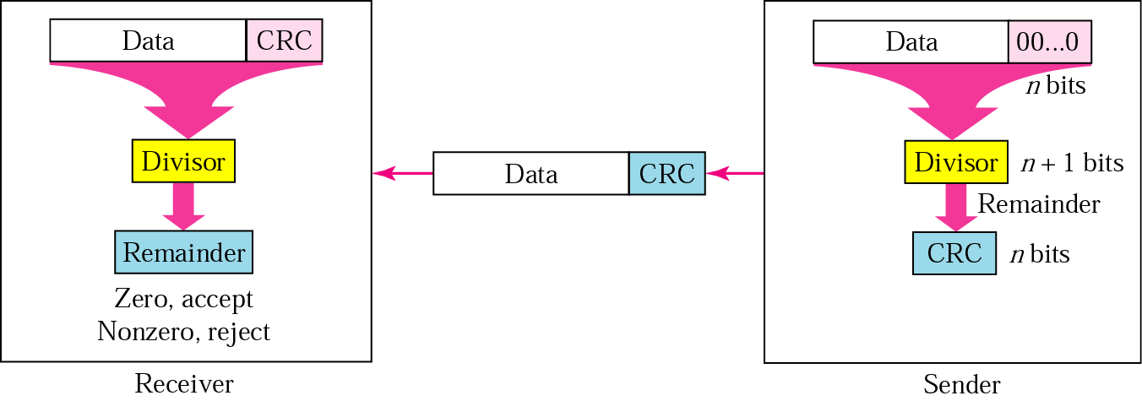
CRC ( CYCLIC REDUNDANCY CHECK):
Note:
CRC can be all zeros

Slide 14
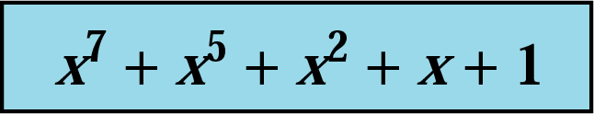
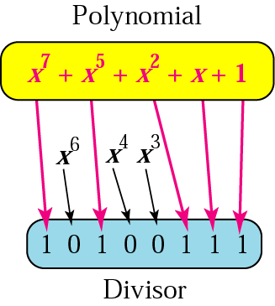
CRC:
CRC Polynomial:
Divisor is represented as a algebraic polynomial but not as a string of o’s and 1’s
Properties:
Should not be divisible by x
Should be divisible by x+1
Guarantees that all burst error of length equal to the degree of polynomial is detected
Guarantees that all burst error of length affecting odd number of bits are detected
Reason for using polynomial:
Short
Used to prove the concept mathematically

Slide 15
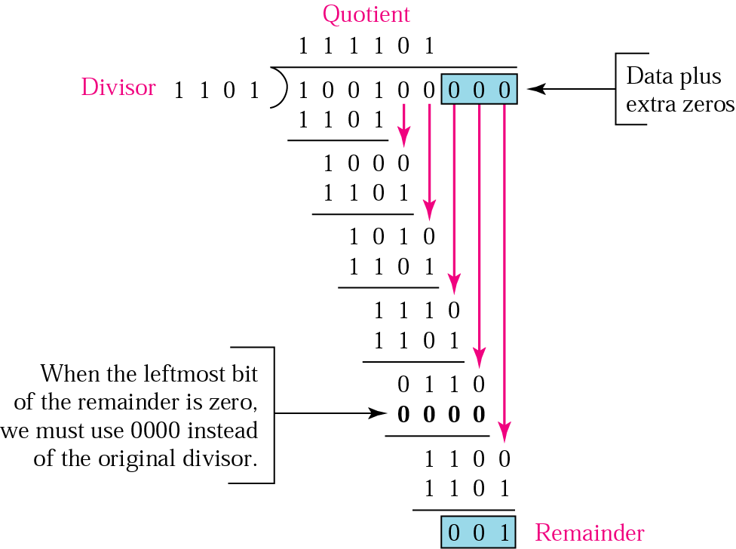
CRC Generator:
Uses mod 2 division
Size of divisor is n+1
n= Number of appended zeros
Divisor always begins with 1
Dividend – divisor and leftmost bit of dividend should be 1
First bit of remainder is zero then use 0000
If second bit is also
zero then it is
retained

Slide 16
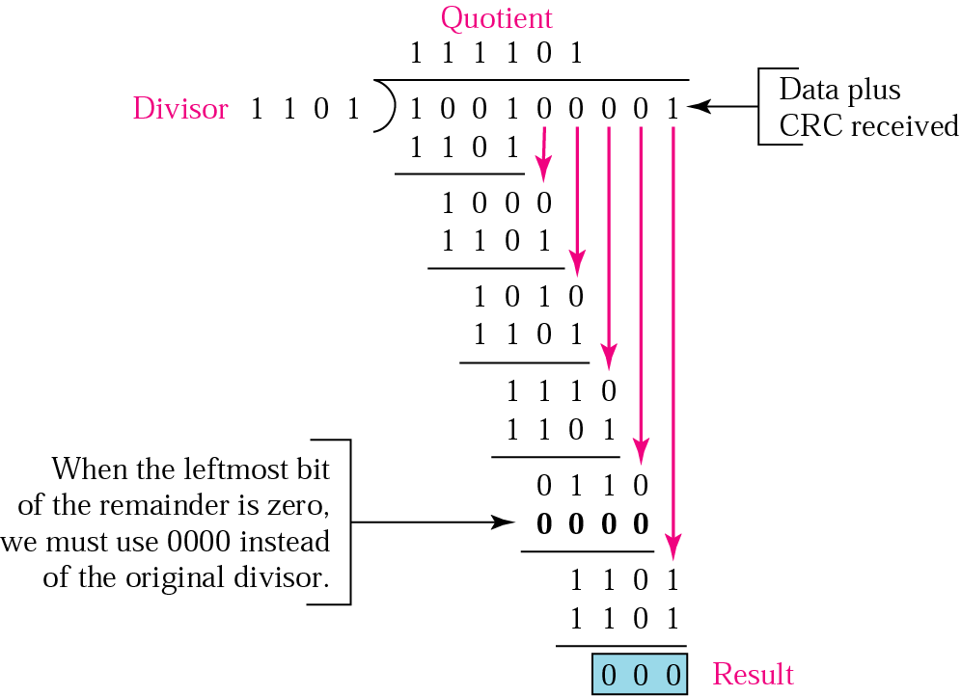
CRC Checker:
Uses mod 2 division
Data is received as data followed by CRC
Remainder=0, CRC is dropped and data is accepted
Else data is discarded and resent

Slide 17
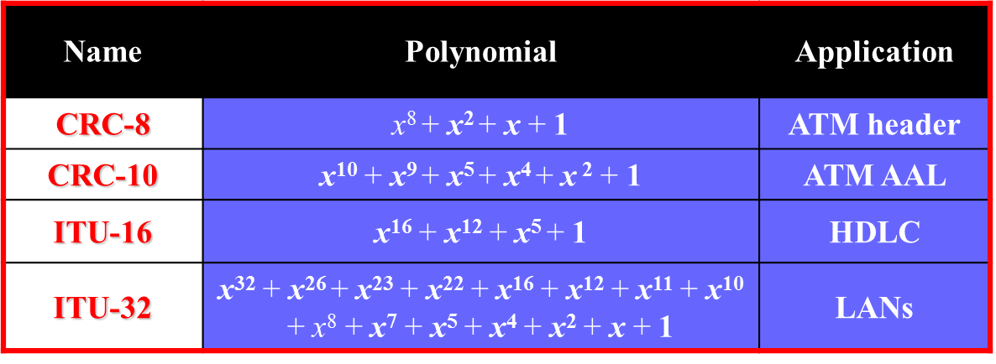
CRC Standard Polynomials:

Slide 18
CRC Polynomials:
Check whether these polynomials can be divisor or not
x
x² + x
x + 1
x² + 1
It is obvious that we cannot choose x (binary 10) or x² + x (binary 110) as the polynomial because both are divisible by x.
However, we can choose x + 1 (binary 11) because it is not divisible by x, but is divisible by x + 1.
We can also choose x² + 1 (binary 101) because it is divisible by x + 1 (binary division).

Slide 19
The CRC-12
x¹² + x¹¹ + x³ + x + 1
which has a degree of 12, will detect all burst errors affecting an odd number of bits, will detect all burst errors with a length less than or equal to 12, and will detect, 99.97 percent of the time, burst errors with a length of 12 or more.

Slide 20
A bit stream 10011101 is transmitted using the standard CRC method. The generator polynomial is x³+1.
What is the actual bit string transmitted?
Suppose the third bit from the left is inverted during transmission. How will receiver detect this error?

Slide 21
Checksum
Checksum is an error detection method.
Error detection using checksum method involves the following steps-
Step-01:
At sender side,
If m bit checksum is used, the data unit to be transmitted is divided into segments of m bits.
All the m bit segments are added.
The result of the sum is then complemented using 1’s complement arithmetic.
The value so obtained is called as checksum.

Slide 22
Checksum
Step-02:
The data along with the checksum value is transmitted to the receiver.
Step-03:
At receiver side,
If m bit checksum is being used, the received data unit is divided into segments of m bits.
All the m bit segments are added along with the checksum value.
The value so obtained is complemented and the result is checked.

Slide 23
Checksum
Then, following two cases are possible-
Case-01: Result = 0
If the result is zero,
Receiver assumes that no error occurred in the data during the transmission.
Receiver accepts the data.
Case-02: Result ≠ 0
If the result is non-zero,
Receiver assumes that error occurred in the data during the transmission.
Receiver discards the data and asks the sender for retransmission.

Slide 24

Checksum
Consider the data unit to be transmitted
10011001111000100010010010000100
Consider 8 bit checksum is used.
At sender side, The given data unit is divided into segments of 8 bits as-

Slide 25
Checksum
Now, all the segments are added and the result is obtained as-
10011001 + 11100010 + 00100100 + 10000100 = 1000100011
Since the result consists of 10 bits, so extra 2 bits are wrapped around.
00100011 + 10 = 00100101 (8 bits)
Now, 1’s complement is taken which is 11011010.
Thus, checksum value = 11011010

Slide 26
Checksum
Step-02:
The data along with the checksum value is transmitted to the receiver.
Step-03:
At receiver side,
The received data unit is divided into segments of 8 bits.
All the segments along with the checksum value are added.
Sum of all segments + Checksum value = 00100101 + 11011010 = 11111111
Complemented value = 00000000
Since the result is 0, receiver assumes no error occurred in the data and therefore accepts it.

Slide 27
Error Correction Methods:
Retransmission
Receiver asks for retransmission of entire data
Forward Error Correction
Burst Error Correction

Slide 28
ERROR CORRECTION:
Forward error correction:
Consider single bit error has occurred in ASCII character, error is detected by error detecting code and error correcting code must determine which 7 bits has changed
Define 8 states
No error
Error in bit 1
Error in bit 2
Error in bit 3
Error in bit 4
Error in bit 5
Error in bit 6
Error in bit 7
Redundancy bits are required to show the above states
3 bit redundancy code is enough to show 000 to 111

Slide 29
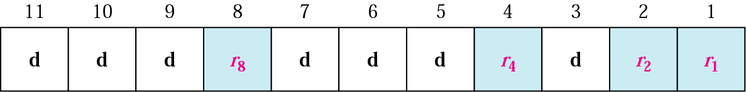
ERROR CORRECTION:
Forward error correction:
Suppose error occurs in redundancy bit itself. i.e. data (7) + redundancy bits (3)=10 bits
If 3 bits are taken then it will identify only 8 states, additional bits are required to cover all error
2^{r} >= m + r + 1
Where m = number of data bits in message
r = number of redundant bits
Length of the resulting code= m + r
If m= 7, then r = ? 4
Redundant bits are represented as r₁, r₂, r₄, r₈
m + r = 7 + 4 = 11

Slide 30
Hamming code:
Provides practical solution
Applied to data unit of any length
Number of data bits m | Number of redundancy bits r | Total bits m + r
1 | 2 | 3
2 | 3 | 5
3 | 3 | 6
4 | 3 | 7
5 | 4 | 9
6 | 4 | 10
7 | 4 | 11

Slide 31
r₈ | r₄ | r₂ | r₁ | No. of bits
0 | 0 | 0 | 1 | 1
0 | 0 | 1 | 0 | 2
0 | 0 | 1 | 1 | 3
0 | 1 | 0 | 0 | 4
0 | 1 | 0 | 1 | 5
0 | 1 | 1 | 0 | 6
0 | 1 | 1 | 1 | 7
1 | 0 | 0 | 0 | 8
1 | 0 | 0 | 1 | 9
1 | 0 | 1 | 0 | 10
1 | 0 | 1 | 1 | 11
1 | 1 | 0 | 0 | 12
1 | 1 | 0 | 1 | 13
1 | 1 | 1 | 0 | 14
1 | 1 | 1 | 1 | 15
r₁ : 1 , 3, 5, 7, 9, 11, 13……..
r₂ : 2, 3, 6, 7, 10, 11………….
r₄ : 4, 5, 6,7, 12, 13, 14, 15,………..
r₈ : 8, 9, 10, 11, 12, 13, 14, 15,………

Slide 32
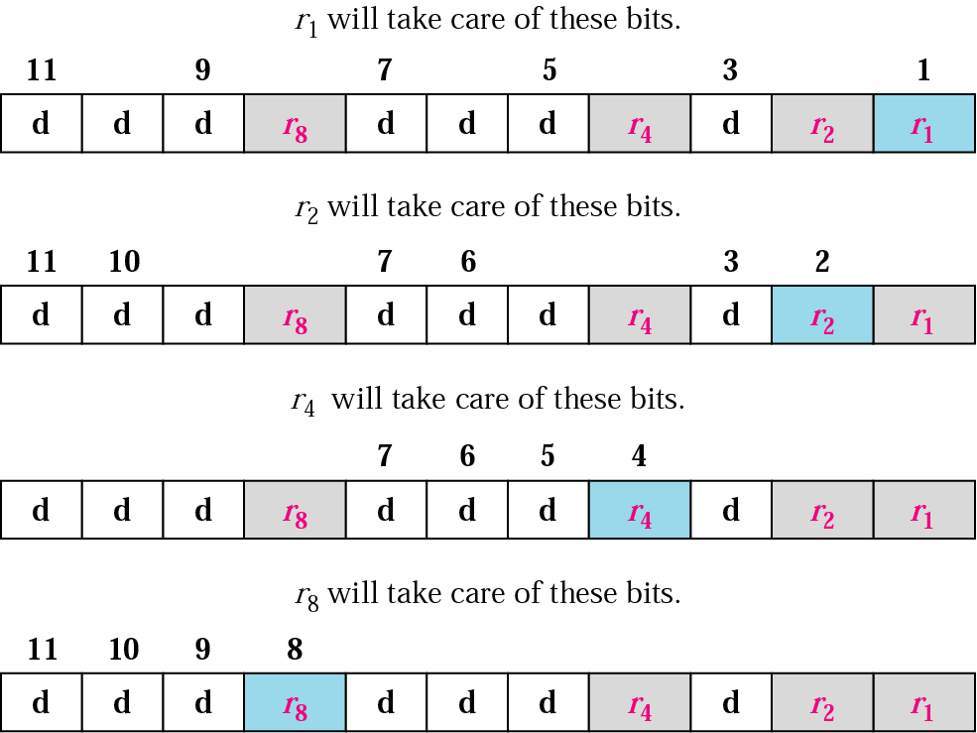
Hamming code:

Slide 33
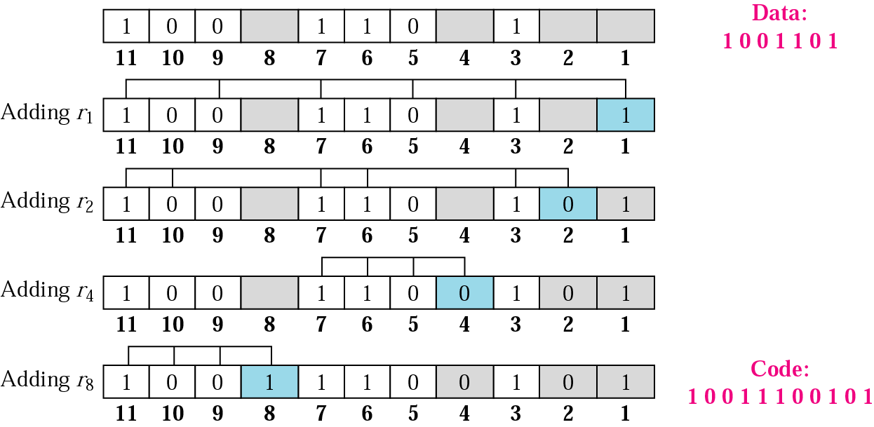
Finding r values:

Slide 34
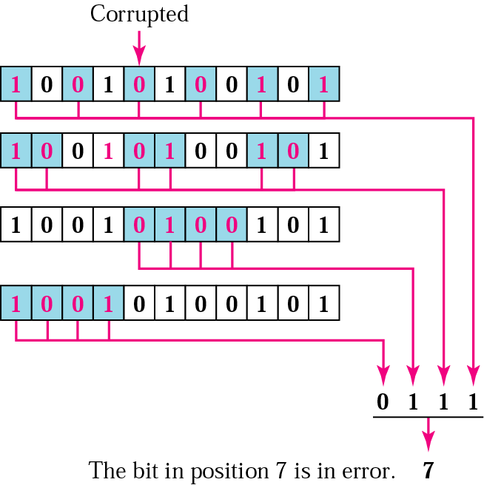
Hamming code:

Slide 35
Hamming code:
Easily implemented using hardware
Code is corrected before the receiver knows about it

Slide 36
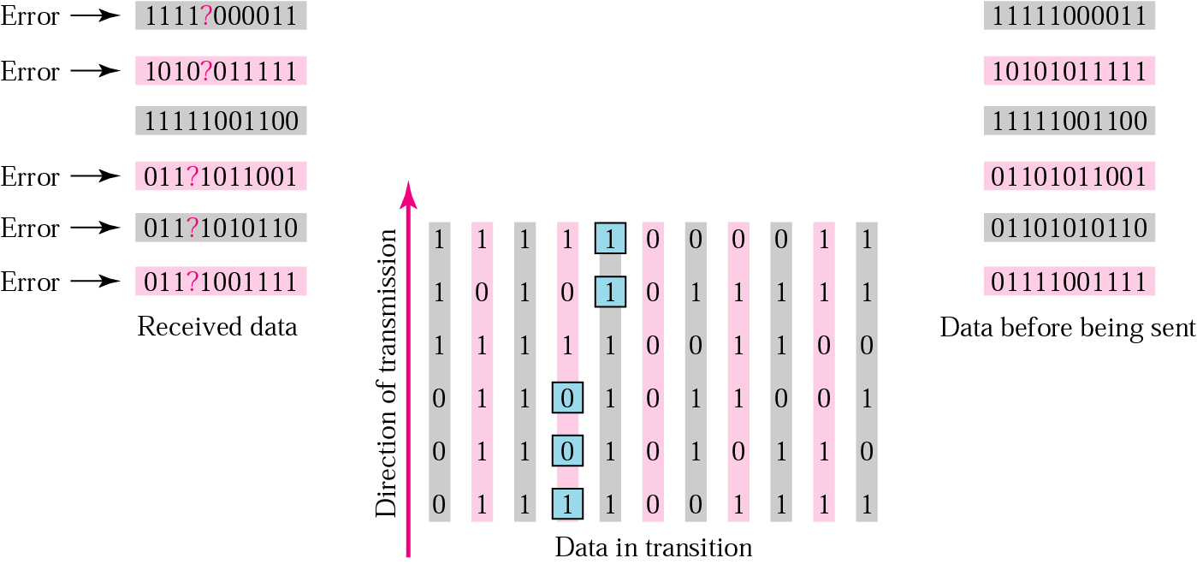
Burst Error Correction:

